Slide 1


Slide 2


Slide 3

Feature Flags
The Art of the IF and Deployment

Slide 4

Chris Ayers Practice Lead, Intelligent Cloud Cognizant Microsoft Business Group
clayers@gmail.com
Twitter: @Chris_L_Ayers
linkedin.com/in/chris-l-ayers/
Blog: https://chrislayers.com/
GitHub: https://github.com/codebytes

Slide 5

Agenda
What are Feature Flags?
Why use Feature Flags?
Operationalizing Flags
Deployment vs Release

Slide 6
What Are Feature Flags?

Slide 7
Original Code
public bool DoStuff(Object[] params)
{
var result = ….;
//blah
return result;
}

Slide 8
What is it?
public bool DoStuff(Object[] params)
{
var useUnicornAlgorithm = false;
// UNCOMMENT IF WORKING ON
// THE UNICORN ALGORITHM
// useUnicornAlgorithm = true;
if( useUnicornAlgorithm )
{
return UnicornImplementation(Object[] params);
}
else
{
return OldImplementation(Object[] params);
}
}

Slide 9
What is it? Feature flags can be simple configuration settings with Boolean values
if (featureFlags.EnableUnicorns)
{
// do something new and amazing here.
}
else
{
// do the current boring stuff.
}

Slide 10
Why Use Feature Flags?

Slide 11
Feature Flags have different uses
Code separation
Minimize disruption to customers
Progressive rollouts
A/B Testing
Kill switch

Slide 12
Short Term
These are used to roll out new features or conduct experiments.
They can be found anywhere, and can be more complex.
They should be cleaned up after the rollout or experiment.

Slide 13
Not all Flags are the same Long Term
Licensing
Advanced features
Integrations
Operational Flags
Load Management

Slide 14
Deployment vs Release

Slide 15
Deployment vs Release
Deploy
Low Risk, repeatable and routine
Installed on Production
Doesn’t mean features are in use
Release
Higher Risk
Business decision
Enables access to a feature
Allows experimentation

Slide 16
Limit the Blast Radius of Change
Internal Users
Progressive Rollouts
Full Deployment
Canary Testing

Slide 17
Operationalizing Flags

Slide 18
Feature Flag Downsides
Feature Flags are Technical Debt As Soon as You Add Them
As you add flags, it can be harder to support and debug the system.

Slide 19
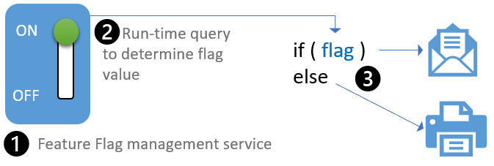
Its all about control
How do you turn it on and off?
Per checkin?
Per server?
Per user?
Dynamically?

Slide 20
Flag Targeting
Targeting Groups
Time
Region
User Details
Percentages
10%/90%
50%/50%
Triggers
Rise in failures
Load

Slide 21
Flag Best Practices
Have a naming convention for short or long term flags
Use meaningful names with long descriptions
Have a central location for flags, one place to look at available flags
The development team should share flags and configurations at the end of a sprint so that the right configuration is released.
NEVER re-purpose a feature flag

Slide 22
SQL/JSON Models
Be additive, never change existing fields
If you have to remove a field, obsolete it until there is no possibility of rollback

Slide 23

Questions

Slide 24


